Slide 1
React.js
React Introduction
Notes:
Add instructor notes here.

Slide 2
Lesson Objectives
At the end of this module you will be able to:
Explain the importance of React.js
Virtual DOM
List advantages of React
Identify React environment setup and React CDN hosting
Notes:
Add instructor notes here.

Slide 3
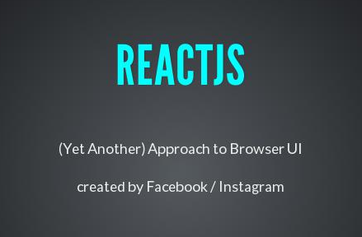
React: Introduction
It is an open source JavaScript library; components are defined and eventually become HTML
Developed by Facebook and Instagram
Intended to be the view("V") or the user interface in MVC
Aims at effortless development of a large scale Single Page Application (SPA)
Notes:
Add instructor notes here.

Slide 4
React: Why React?
React code is easy to understand for developers, designers, and anyone with the knowledge of XML or HTML
It uses JSX which is clean and easy to understand syntax which can be used directly in our JavaScript
Easy to test
Renders quick views
Enforces good coding practices
Supported and used by Facebook
Notes:
Add instructor notes here.

Slide 5

Virtual DOM
"React abstract away the DOM from you, giving a simpler programming model and better performance"
- React
Notes:
DOM needs to be manipulated at first, because web applications are not static. Web applications have a state represented by the user interface (UI) that a web browser renders, and that state can be changed when an event(User events and Server events) occurs.
User events: When a user types, clicks, scrolls, resizes, and so on
Server events: When an application receives data or an error from a server, among others.
When we handle the above mentioned events, we update the data that our application depends on
Add instructor notes here.

Slide 6
Virtual DOM
A DOM(Document Object Model) represents web page in a tree structure. It also refers how these page elements are accessed and changed
Updating the DOM is expensive
Reading and writing to DOM using DOM API are slow because they are not optimized for speed
JavaScript Objects are faster than DOM Objects
React offers the Virtual DOM which is a pure JavaScript intermediate representation of DOM
React never reads from the real DOM. It only writes to real DOM if needed, so it efficiently handles DOM Updates
The process of updating only part of the DOM structure is called as "reconciliation"
Notes:
Virtual DOM is nothing but React’s local and simplified copy of the HTML DOM. It allows React to do its computations within this abstract world and skip the “real” DOM operations, often slow and browser-specific.
There’s no big difference between the “regular” DOM and the virtual DOM. In most cases, HTML code can be change to a static React component by doing the following :
Return the HTML code in render
Replace class attribute name to className - because class is a reserved word in JavaScript.
Three attributes of the virtual DOM that don’t appear in “real” DOM are :
key,
ref
dangerouslySetInnerHTML.
Add instructor notes here.

Slide 7
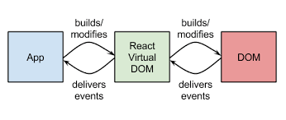
React and Virtual DOM
React offers the Virtual DOM which is a pure JavaScript intermediate representation of DOM
React never reads from the real DOM. It only writes to real DOM if needed, so it efficiently handles DOM Updates
The process of updating only part of the DOM structure is called as "reconciliation"
Notes:
Virtual DOM is nothing but React’s local and simplified copy of the HTML DOM. It allows React to do its computations within this abstract world and skip the “real” DOM operations, often slow and browser-specific.
There’s no big difference between the “regular” DOM and the virtual DOM. In most cases, HTML code can be change to a static React component by doing the following :
Return the HTML code in render
Replace class attribute name to className - because class is a reserved word in JavaScript.
Three attributes of the virtual DOM that don’t appear in “real” DOM are :
key,
ref
dangerouslySetInnerHTML.
Add instructor notes here.

Slide 8
How Virtual DOM Works?
Whenever the data model state changed, the virtual DOM and React will re-render the UI to a virtual DOM representation
React calculates the difference between the two virtual DOM representations: the previous virtual DOM representation that was computed before the data was changed and the current virtual DOM representation that was computed after the data was changed. This difference between the two virtual DOM representations is what actually needs to be changed in the real DOM
React updates only what needs to be updated in the real DOM
DOM
React Virtual DOM
JS Logic
Notes:
Add instructor notes here.

Slide 9
React: How React Renders the View?
JSX Code written describing the basic application
JSX is converted into JavaScript by the compiler
React turns converted JSX into a Virtual DOM
Virtual DOM is applied to Real DOM
Underlying Data Model is updated
React Updates Virtual DOM and then updates the real DOM in efficient Manner
Notes:
Add instructor notes here.

Slide 10
React: Advantages
Easy to know how a component is rendered just by look at the render function
JSX makes it easy to read the code of components. It is also easy to see the layout, or how components are plugged/combined with each other
Can be rendered on the server-side
Easy to test and integrated with tools like jest
Ensures readability and makes maintainability easier
Can be used with any framework like Backbone.js, Angular.js as it is only a view layer
Notes:
Add instructor notes here.

Slide 11
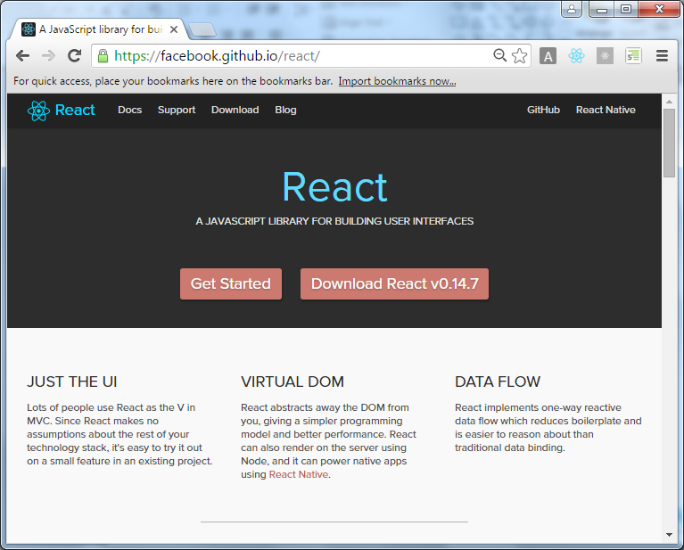
React Official Website

Slide 12
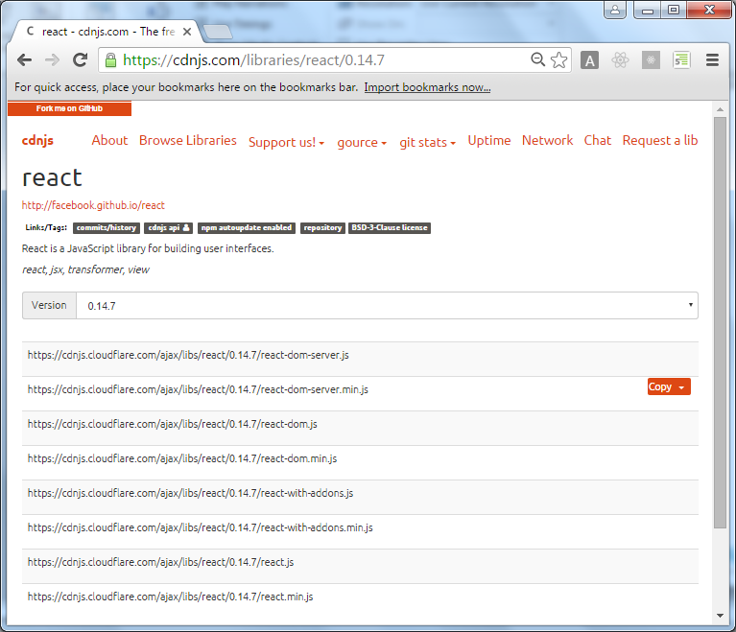
React CDN Hosting

Slide 13
Summary
In this module you learnt that:
React is a JavaScript Library to build user interfaces for modern web applications
React is intended to be the view("V") or the user interface
Virtual DOM is nothing but React’s local and simplified copy of the HTML DOM
Virtual DOM allows React to do its computations within it and skip the “real” DOM operations which is often slow and browser-specific
React can be used with any framework as it is only a view layer
The process of updating only part of the DOM structure is called as "reconciliation"
Notes:
Add the notes here.
Add instructor notes here.

